Slide 1
Conceptual Graphs with Amine
Benjamin Chu Min Xian

Slide 2
Overview
Preliminary Concepts
Conceptual Graphs (CG) Operation in Amine
Applied Possibilities – why CG?
www.mimos.my
© 2008 MIMOS Berhad. All Rights Reserved.

Slide 3
Preliminary Concepts
Conceptual Graph
A knowledge representation technique to transform text into labeled graph with “concept” nodes connected by “relation” nodes.
E.g. Haley repair his Ferrari at 3pm.
[Time: 3pm]<-(PTim)<-[Situation: [Person:Haley]<-(Agnt)
<-[repair]-
{
(obj)->[car:Ferrari]->(Poss)->[Person:Haley]
} ]
Relation
Type
Concept Type
Individual Type
www.mimos.my
© 2008 MIMOS Berhad. All Rights Reserved.

Slide 4
Preliminary Concepts
Amine
Platform of CG manipulation system implemented in Java: CG (ontology, graphic and linear form editors), a package of CG operations and Prolog +CG
http://amine-platform.sourceforge.net/
www.mimos.my
© 2008 MIMOS Berhad. All Rights Reserved.

Slide 5
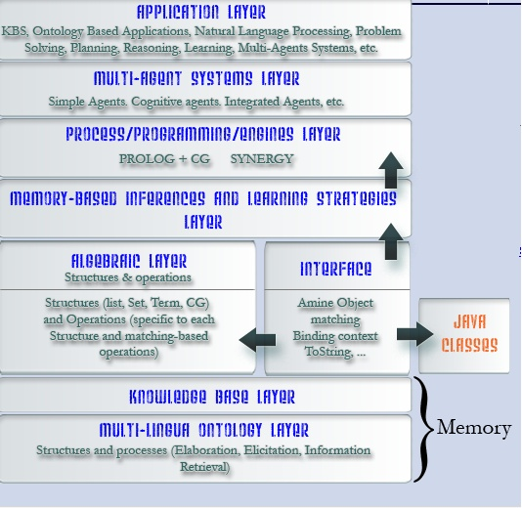
Amine Platform
www.mimos.my
© 2008 MIMOS Berhad. All Rights Reserved.

Slide 6
CG Operations in Amine
Maximal Join
A sequence of joins and simplification applied to the matching of nodes of 2 graphs.
Generalize
Expand
Prolog +CG – Rule-based and Pattern Matching
www.mimos.my
© 2008 MIMOS Berhad. All Rights Reserved.

Slide 7
Applied Possibilities
CG = visual, diagrammatic, expressive?
Information Fusion
- Use the aggregation operators such as maximal join to help to model information from various sources distributed across different media.
- Document summarization.
Intelligent Query Engine
Geographic Knowledge Representation
www.mimos.my
© 2008 MIMOS Berhad. All Rights Reserved.

Slide 8
www.mimos.my
© 2008 MIMOS Berhad. All Rights Reserved.

